Slide 1
Cloudflare Zero Trust (Cloudflare for Teams)
SE Stand and Deliver Support Deck
Presented by Antonio Rancan

Slide 2
What we will cover
Cloudflare One Overview
Cloudflare for Teams Overview - Access, Gateway, Browser
Hands On / Dashboard Runthrough
Presales Notes
Competitive Notes
Stand and Deliver
Resources

Slide 3
Cloudflare One

Slide 4
Cloudflare’s Product and Service Portfolio
Building a better Internet through performance, security, and reliability solutions
Web Applications
Workforce
Networks
Web Application Firewall
Bot Management
Rate Limiting
Layer 7 DDoS protection
CDN
Load Balancing
Access (Zero Trust)
Gateway (SWG/FWaaS)
Remote Browser Isolation
CASB*
DLP*
Magic Transit
Magic Firewall
Spectrum
Network Interconnect
Magic WAN*
Developer Platform
Cloudflare Workers
Cloudflare Workers KV
Cloudflare Network Infrastructure
Stream Delivery | Argo Smart Routing | Analytics | Cloudflare Logs
Authoritative DNS | Recursive DNS | DNSSEC | DNS over HTTP | mTLS | SSL/TLS | Data Protection
51 Tbps Network Capacity | 200+ cities | 100+ countries | China Network
Notes:
A lot of people struggle to understand what Cloudflare One is within the scope of our product offerings. In many ways, you could use all of Cloudflare’s products together, in an integrated fashion and you’d have a SASE plus solution, I’ll call it. The key components, as it’s designed though, involve combining Cloudflare for Teams products, shown here in the Workforce section with Magic Transit and Magic Firewall, shown in the Network section. We talked about the important of a robust, distributed network. That is our biggest strategic advantage. Our network underpins everything we do here.

Slide 5
Cloudflare’s Product and Service Portfolio
Building a better Internet through performance, security, and reliability solutions
Web Applications
Workforce
Networks
Web Application Firewall
Bot Management
Rate Limiting
Layer 7 DDoS protection
CDN
Load Balancing
Access (Zero Trust)
Gateway (SWG/FWaaS)
Remote Browser Isolation
CASB*
DLP*
Magic Transit
Magic Firewall
Spectrum
Network Interconnect
Magic WAN*
Developer Platform
Cloudflare Workers
Cloudflare Workers KV
Cloudflare for Teams
Cloudflare One
Cloudflare Network Infrastructure
Stream Delivery | Argo Smart Routing | Analytics | Cloudflare Logs
Authoritative DNS | Recursive DNS | DNSSEC | DNS over HTTP | mTLS | SSL/TLS | Data Protection
51 Tbps Network Capacity | 200+ cities | 100+ countries | China Network
Notes:
A lot of people struggle to understand what Cloudflare One is within the scope of our product offerings. In many ways, you could use all of Cloudflare’s products together, in an integrated fashion and you’d have a SASE plus solution, I’ll call it. The key components, as it’s designed though, involve combining Cloudflare for Teams products, shown here in the Workforce section with Magic Transit and Magic Firewall, shown in the Network section. We talked about the important of a robust, distributed network. That is our biggest strategic advantage. Our network underpins everything we do here.

Slide 6


Enterprise Networks were built for 2010
IPsec VPN
IPsec VPN
Business Partner
Internet
Mobile Worker
MPLS/
Leased
MPLS/
Leased
Router
Router
Router/Switch
Load Balancer
Core Switch
WAN Optimizer
Enterprise Firewall
Firewall/VPN
SMB Firewall
DDoS Mitigation
Secure Web Gateway
Wireless Access Point
...
...
...
Headquarters
Data Center
Branch Office
Notes:
A big part of the problem is that most corporate networks were architected assuming that location, headquarters, data centers, and branch offices were the primary building blocks of the network and the foundation for security.

Slide 7

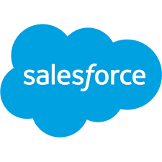

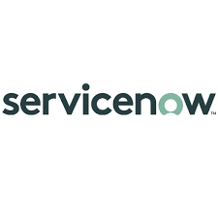
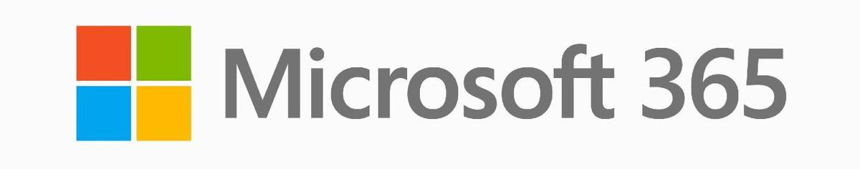
How we work changed, but the network did not
IPsec VPN
IPsec
VPN
Business Partner
Internet
Mobile Worker
MPLS/
Leased
MPLS/
Leased
Router
Router
Router/Switch
Cloud Router
CASB
Load Balancer
Core Switch
WAN Optimizer
VPC
Enterprise Firewall
Firewall/VPN
SMB Firewall
Security Groups
DDoS Mitigation
Secure Web Gateway
Wireless Access Point
Cloud NAT
...
...
...
Headquarters
Data Center
Branch Office
Public Cloud
Notes:
Despite the majority of enterprise workloads moving to the public or private clouds or SaaS applications accessed over the internet, and most users working from remote offices or completely mobile, the network has remained largely the same.

Slide 8
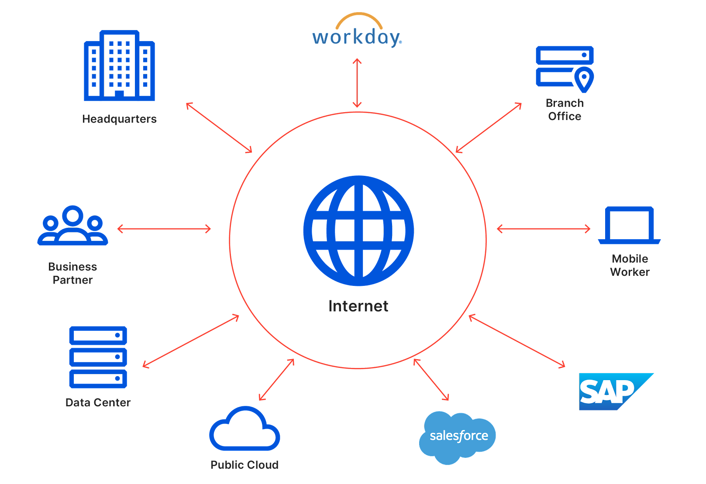
The Internet is now the corporate network
HOW DO YOU BUILD A PERIMETER AROUND THE INTERNET?
The network must be:
Everywhere
Secure
Fast
Reliable
Intelligent
Software-defined
Notes:
Modern business requires a modern network. As the Internet becomes where your customers, employees, and vendors interact with your business, how do you scale the traditional castle and moat security model? You can’t just scale boxes to wrap the Internet in a secure firewall. The Internet is your new corporate network and your employees, partners, and customers need a network that is everywhere, secure, fast, and reliable to get work done.

Slide 9
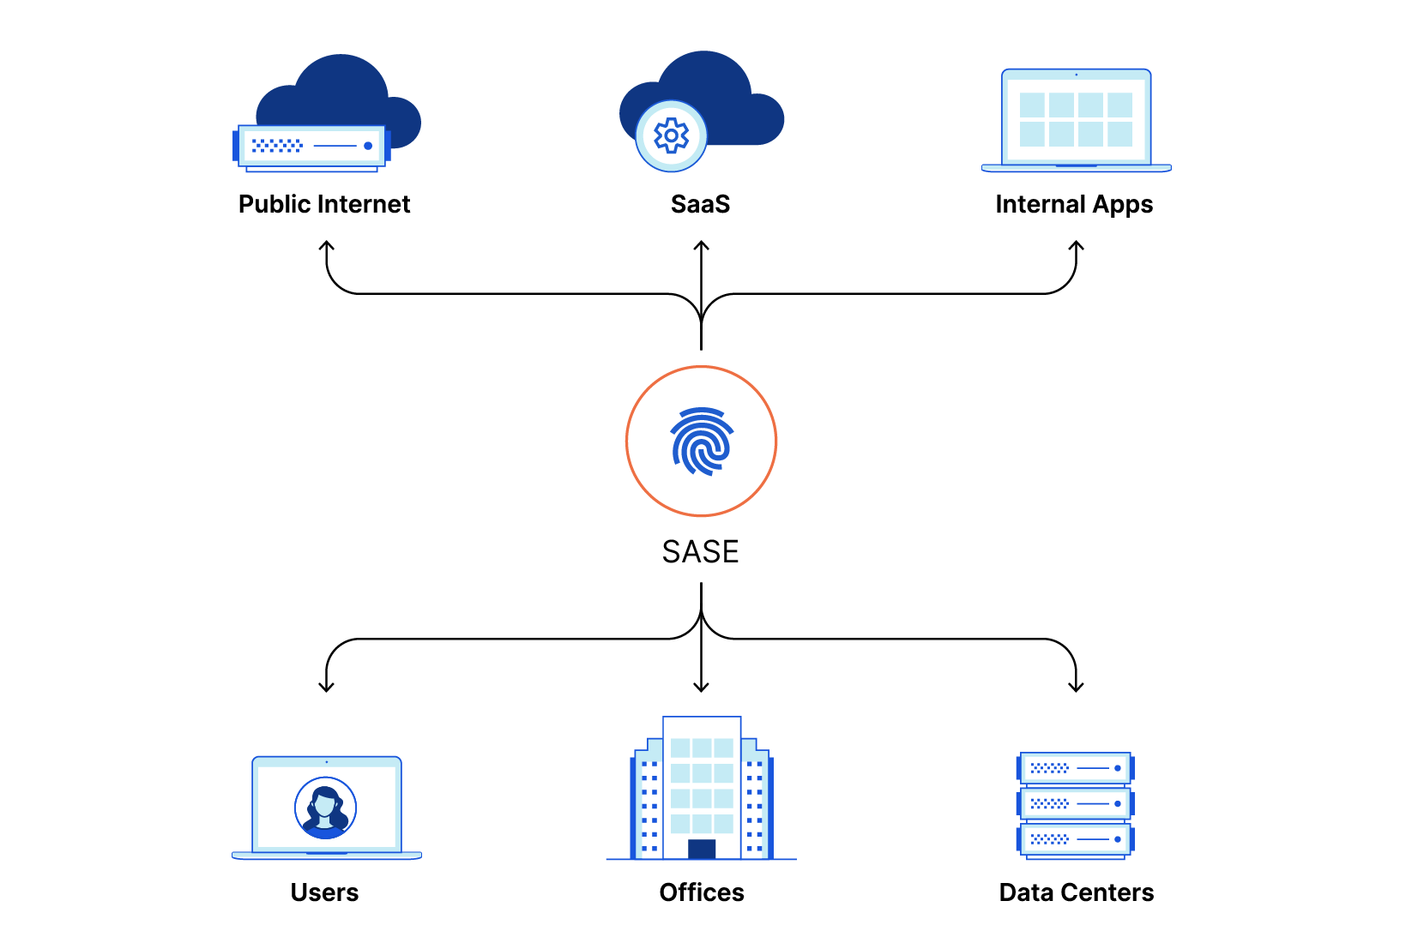
The Industry is recognizing this evolution
THE FUTURE OF NETWORK SECURITY WILL BE DELIVERED FROM THE EDGE
 | Industry | Gartner | Forrester
Reference Architecture | Network-as- a-Service | SASE | ZT Edge
Security Model | Software Defined Perimeter (SDP) | Zero Trust → Adaptive Trust | Zero Trust (ZTNA)
Requirements | Cloud native and software defined, centralized policy enforcement, a single management and data plane, robust visibility and logging
What SASE is not | On-premise technologies shifted to a public cloud, a portfolio of disparate acquisitions
Notes:
Industry analysts are describing the shifting needs of a new network model, clearly stating that security and performance need to be built into how users connect to the internet as it serves as the new corporate network for access to enterprise applications, data, and other resources.
Gartner coined the term SASE or Secure Access Service Edge in September of 2019 to describe the future of network performance and security converging into a consolidated, cloud delivered service that requires a large and distributed edge network at it’s foundation. Forrester has similarly described their version as the ZT Edge. Generically SASE and ZT edge can be thought of as “Network-as-a-service.” This is really speaking to the architecture of ‘how’ those solutions will be delivered in comparison to traditional appliances located in your datacenter protecting your perimeter.
One of the key components in this new model is a shift to a Zero Trust security which requires every user be authenticated on every request for access in contrast to the old castle and moat model which considered a user “inside” the network as safe. This new model is also referred to as a Software Defined Perimeter because rather than relying on “location” as the core principle, it uses software-defined policies to enforce access security.
Gartner and Forrester agree that the network-as-a-service needs to be a comprehensive platform, not a collection of disparate software applications cobbled together by a legacy vendor through acquisitions or a lift-and-shift of legacy appliances to a public cloud hosted delivery model. This is really important. If the platform isn’t cloud-native, providing a single pass inspection of traffic and a single pane of glass for visibility and control of all of that traffic, it will introduce latency and increased risk as each hop between those legacy solutions presents a new seam in the architecture.

Slide 10
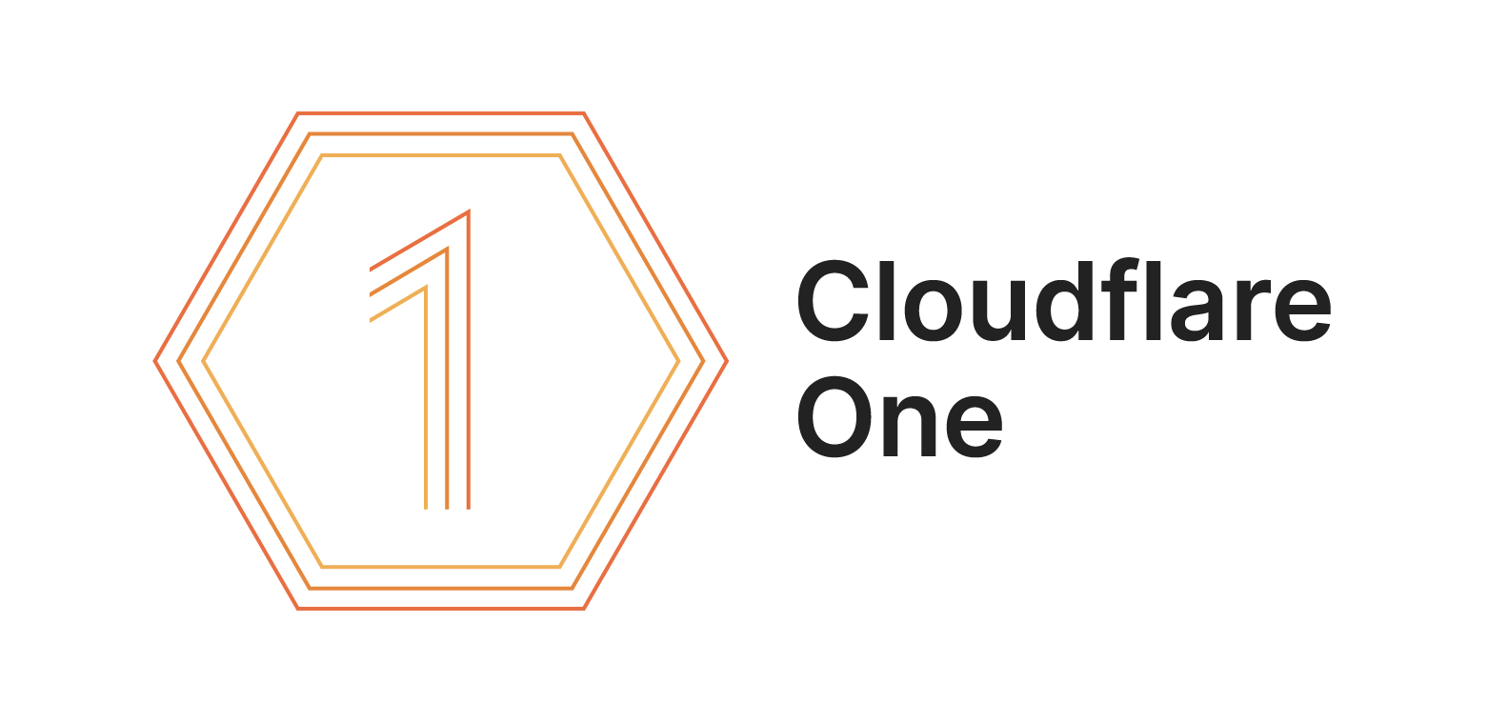
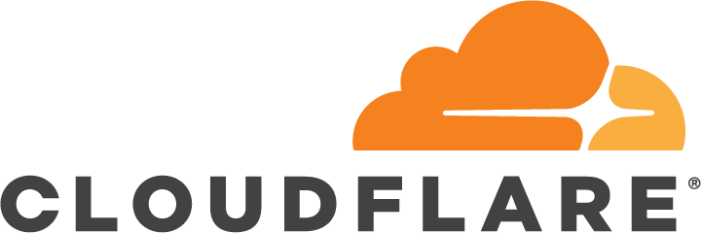
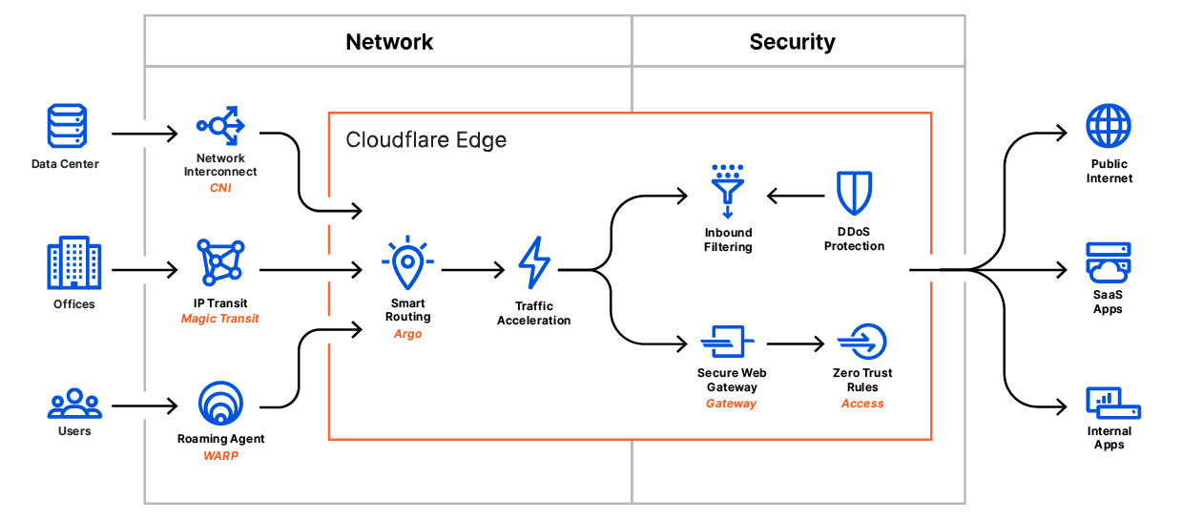
Notes:
Cloudflare One is a new platform that connects remote users, data centers, and offices securely to Cloudflare’s network, where their requests are routed over the fastest path and filtered based on your enterprise security policy.

Slide 11
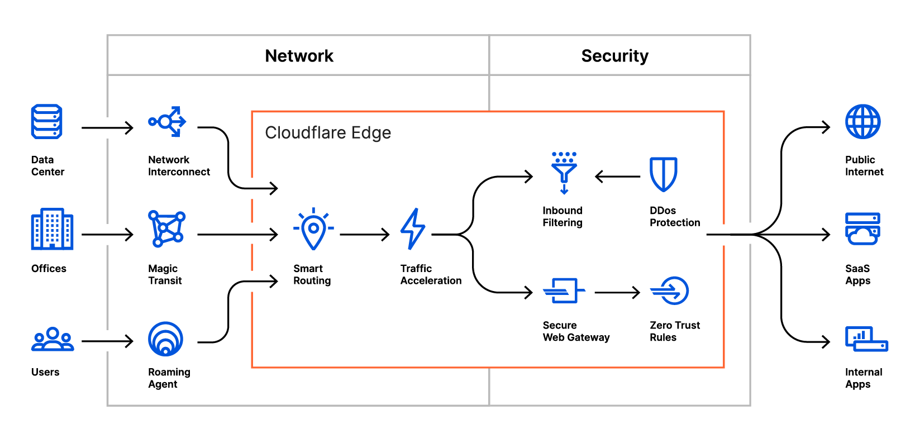

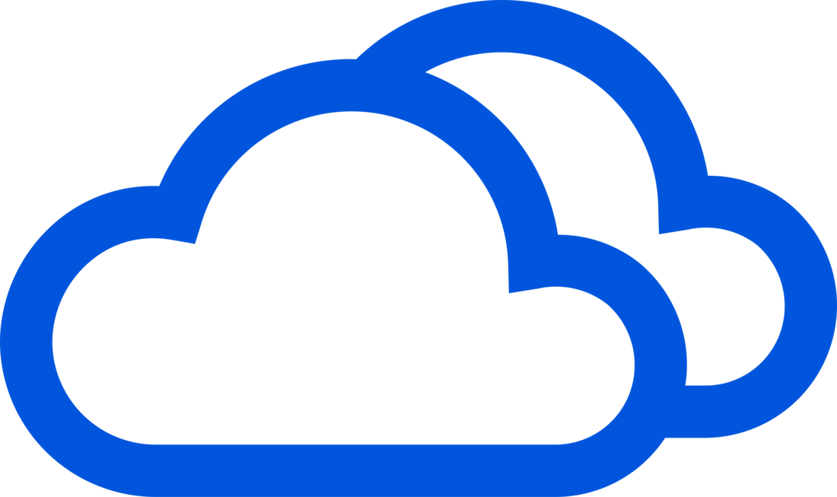




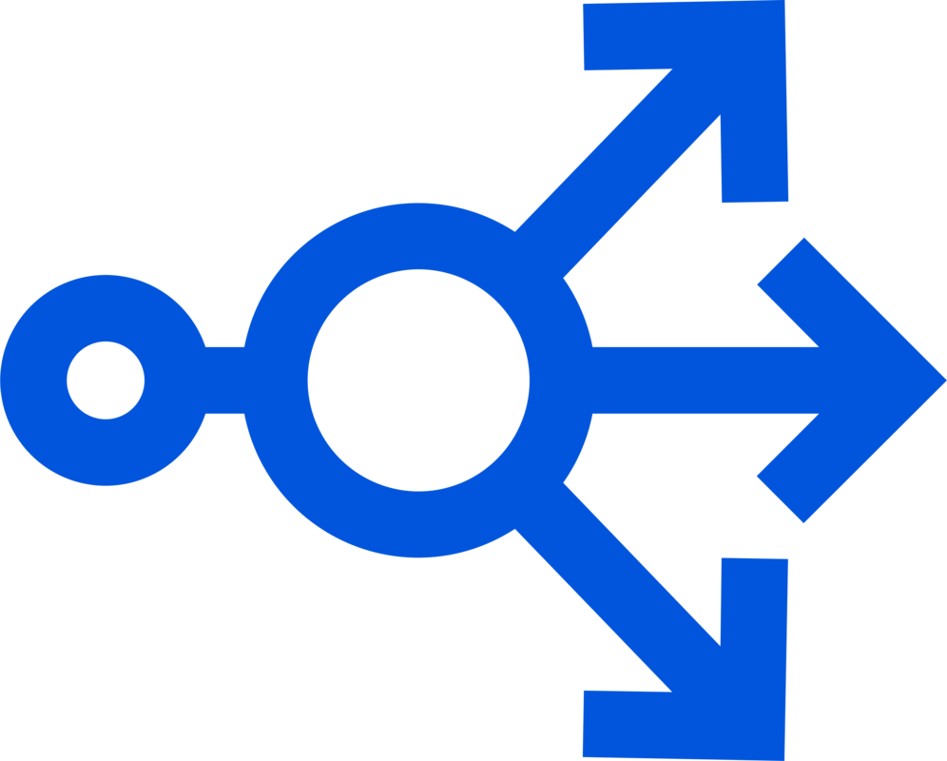
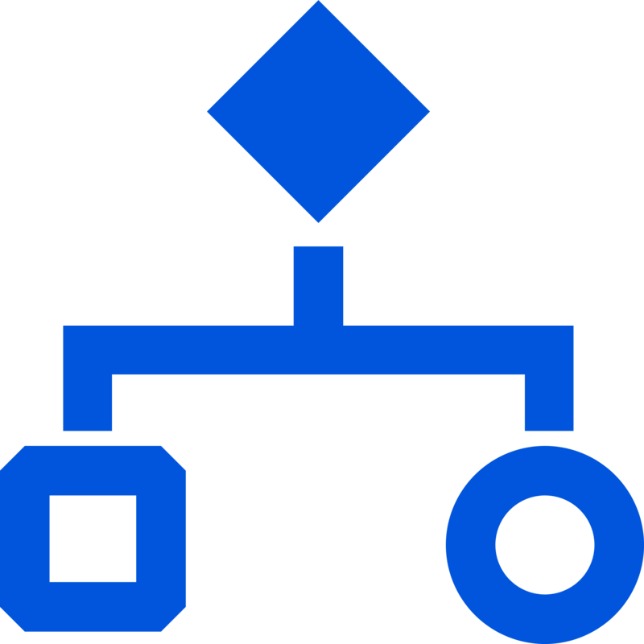



Connect any source to any destination, with any on-ramp, through Cloudflare’s network.
Sources & Destinations
Data centers
Offices
Devices
Public Internet
Cloud providers
On-Ramps
Direct connection
BYOIP
Roaming agent
GRE/IPSec/Argo tunnel
Reverse proxy
Seamless integration with Cloudflare security, performance, & visibility products
Cloudflare Global Network
Security
Performance
DDoS
protection
Network
firewall
Zero Trust
rules
Secure Web Gateway
IDS/IPS
Traffic acceleration
Load balancing
Quality of Service
Visibility
Analytics
Logs
Reports
Insights

Slide 12
Cloudflare for Teams
Cloudflare Access: Zero Trust Network Access
Cloudflare Gateway: Secure Web Gateway
Cloudflare Browser: Remote Browser Isolation

Slide 13
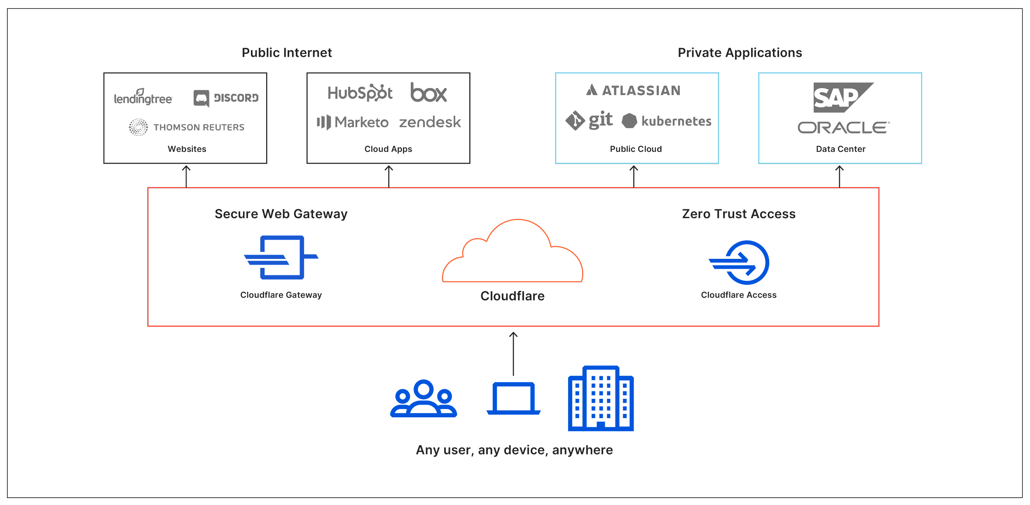
CLOUDFLARE FOR TEAMS
Notes:
Cloudflare for Teams is our Zero Trust security platform that securely connects your employees to corporate resources and the Internet, without latency.
The two core products that make up Cloudflare for Teams are Gateway, a Secure Web Gateway to protect your users and data on the open internet and Access, a zero trust solution that enforces unified access policies to applications based on identity and context instead of simply location. Together, these two solutions provide a powerful single pane of glass enabling administrators to manage user and network security from a single platform.
Let’s dive deeper into each of those products to explore the specific features.

Slide 14
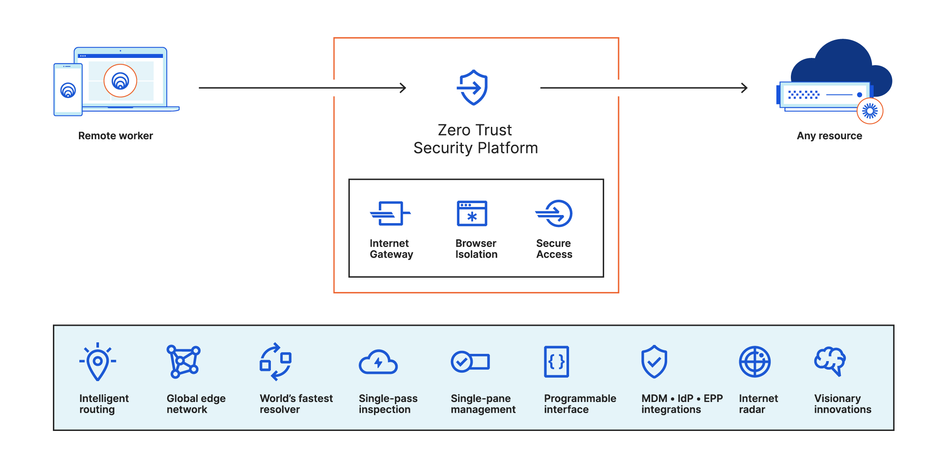
Our Zero Trust security platform
Notes:
Why are people replacing?
Performance
Cost - inefficient/redundant traffic flows - sending traffic through data centers to take on that burden is difficult
Increaing bandwidth that’s going in and out of those data centers
Adaptability/agility to adapt to changes in traffic patterns Longer term plan
Why do it with Cloudflare?
Access to applications needs to be seamless and secure
Have the same policies and the same visibility extend to how they interact over the Internet
Other competitors address this with two or more separate products
Speed of getting started - one product
We can show definitively how much easier it is

Slide 15
Cloudflare Access

Slide 16

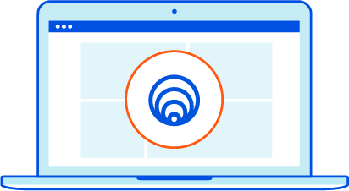
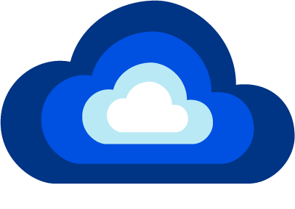
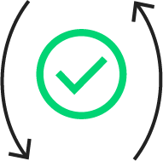
Every Data Center in 200+ Cities
Cloudflare
Users
Multicloud
Identity Verification
Device Posture

Slide 17
Cloudflare Gateway

Slide 18
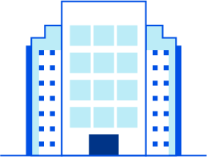

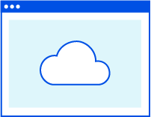

Cloudflare Gateway
Identity-Based Policy Engine
Recursive DNS Resolver
Security, Content, and Application Groups Domain and IP Filters
DNS query
Office user
Known location IP
Coming soon: L4-7 traffic
Traffic Inspection Proxy
HTTPS Decryption, File and Data Scanning, AV URL, HTTP, and MIME/File Type Filters
app.com
Encrypted L4-7 traffic
Zero Trust Browser
Untrusted Web Code Executed Away From Device Coming Soon: Copy/Paste, Print, Input Controls
Remote user
Device Agent
Notes:
V2

Slide 19
Cloudflare Browser

Slide 20
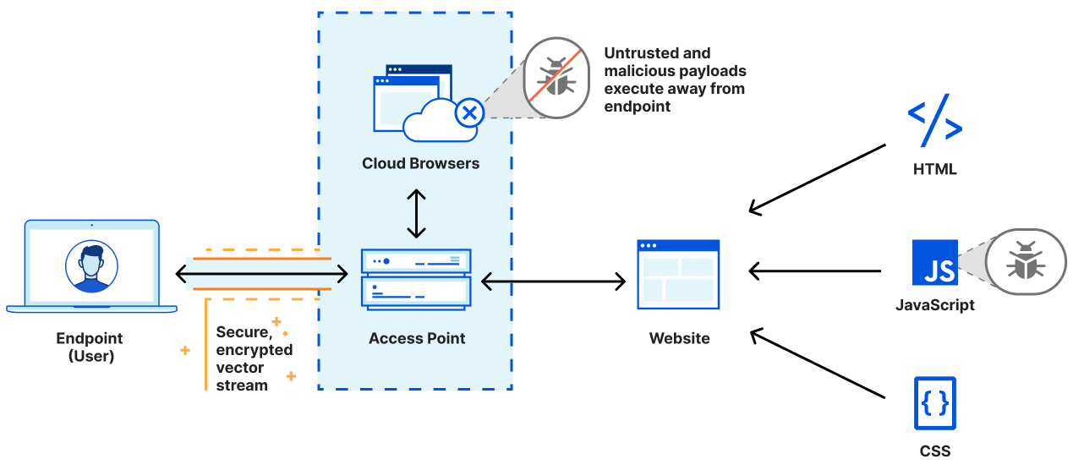
Isolate endpoints from untrusted and malicious web code

Slide 21
Dashboard Run Through
https://developers.cloudflare.com/cloudflare-one/

Slide 22
Dashboard Run Through
Access
Configure IDP
Policies
Basic Self-Hosted HTTP
Access for SaaS
Non-HTTP: E.g. RDP/SSH
Device Posture
Require Gateway
Mutual TLS*
Other: Azure AD / Tanium*
Argo Tunnel
Logs/Logpush
Other
JWT Validation*
Short Lived Certificates*
Service Auth*
Gateway
DNS
Locations
Policies
L7
Policies
Client-Side Installation
Logs/Logpush
Browser
Creating a Gateway Policy with Isolate
Demo End User Experience

Slide 23
Presales Notes

Slide 24
Remote Worker Sales Play Cheat Sheet
Opportunity:
COVID-19 forced an overnight transition to remote work. Businesses scrambled to keep employees connected, and applied tactical bandaids — like doubling down on slow and unreliable VPNs, split-tunneling Internet traffic, and applying hasty remote access hacks. In 2021, security teams will prioritize addressing the gaps in their remote worker strategy, and Cloudflare’s Zero Trust platform is the perfect solution for their needs.
Align messaging to 3 value pillars with quantified outcomes
Blind too often | Way too complex | Excessive trust
“We can’t produce an audit trail of the data and apps remote workers access. We don’t see enough to build the right policies.” | “We’re stitching together a mix of network and security tools with configurations that no longer make sense for remote workers.” | “The tools we use to connect remote workers to corporate apps and the Internet grant excessive trust, exposing us to potential data loss.”
Users often turn VPN off? Most traffic splits off VPN? Logs siloed in app or FWs? | Too many IP-based rules? Inconsistent policies? Weak device posture? | Can’t limit access via VPN? Threats evade proxy/patch? VPN is single failure point?
↓ | ↓ | ↓
Restore visibility | Eliminate complexity | Reduce risk
“30 minutes later, we had achieved the first two steps in our journey to Zero Trust security.” Security Engineer | “Measured a 80% reduction of time spent resolving IT tickets and security posture for remote workers.” Director of IT | “Enabled a 91% reduction to our attack surface by putting Cloudflare in front of our app access & internet browsing.” CISO (per Gartner)
Require gateway to be on to access apps Monitor use of sanctioned and unsanctioned apps Central logs to investigate security/policy incidents | Simple user/device-based rules to control access Global policy enforcement with ultra-low latency Works for managed and unmanaged devices | Require identity/posture verification & limit access Isolate malware/phishing from user device/input Isolate apps from Internet Resilient remote access
Solution scope: Selling security for a workforce (not one team)
Where possible, avoid pitching Access, Gateway, and Browser Isolation as point solutions. Shift from solving one pain point for a few users to discovering many use cases that overlap 10x as many users to pitch our Zero Trust platform!
Targeting the right customer
Tech | Moderate-high cloud adoption, IAM/MDM/EPP in use (see pg3 for acronyms)
Size | 200-10,000 users with similar pains for any size (shorter sales cycle <2,000)
Buyer | IT department w/security decision-making authority or security department
Industry | Best product/play fit: technology, pro services, (fit gaps*) financial services Good product/play fit: media/comm, healthcare, mfgr/utility, retail/hospitality Least product/play fit: government--notably Fed, education--notably K-12
*varies; hedge funds good fit, whereas banks have mature DLP/CASB and region control use cases
Go after | Buyer prioritizes set-forget with minimal overhead over in-depth reporting No stand-alone SWG, rather use NGFW/UTM including URL filters Not many office locations, with some offices in tier 2-3 cities
Caution | Enterprise SOC buyer; focus on threat detection & endpoint integration Some business-critical legacy or thick-client apps (*private routing will help) Use hybrid SWG solution - if so, attack weak cloud performance
Avoid | Existing ZTNA solution or already using Zscaler or PAN Prisma Most apps are SaaS with adv access management deployment like Okta Deploying SD-WAN; focused more on direct internet breakouts for offices
Propose phased rollout that starts without disruptions
Step 1 - Access ---------→ | Step 2 - Gateway ------→ | Step 3 - Browser Isolation
Add 1st layer of Zero Trust security without disruptions to reduce risk | Reduce reliance on VPN and on-prem, proxy-based security to restore visibility | Add 2nd layer of Zero Trust security with one click to reduce risk

Slide 25



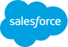
Competitive positioning
Remote Worker Sales Play Cheat Sheet
Shift the conversation from features to use cases
Start with 6 use cases | Questions
Connect remote workers to corporate apps | How are you handling remote user traffic? Are you routing some or all of your traffic over a VPN? Do you have any filtering policies in place?
Adopt Zero Trust security for application access | How granular is your access control today? Using multifactor authentication? Are hardkeys required?
Adopt Zero Trust security for Internet browsing | How do you keep browsers or plugins always up to date? Can you trust users to know that a site is phishing them?
Protect data from uploads and unauthorized access | Do you need to control the movement of data in/out of SaaS apps? Or apps you built in the public cloud?
Protect devices from malicious code in a site | Confident in your endpoint security stopping all threats? What’s your policy for users visiting a newly seen site?
Protect users from phishing sites | If a new phishing site were discovered, how would you go about blocking it today?
Mid-market | Cisco Umbrella (1. DNS Filter, 2. SWG, 3. CASB) + Duo (1. MFA, 2. ZTNA)
Enterprise | Zscaler ZIA (1. SWG, 2. CASB, 3. NGFW) + ZPA (1. ZTNA) PAN Prisma Access (1. NGFW, 2. SWG, 3. ZTNA) + Prisma SaaS (CASB)
Our strength | Why customers will care | Their weakness
Less time to layer on zero trust access | No changes to, or incompatibilities with, existing VPN set up. No software or API config for SaaS apps, simple server daemon for internal apps, unlike competitors. | PAN: full traditional VPN setup Cisco: not cloud-based Zscaler: favors client & ZPA policy doesn’t cover SaaS
Less time to layer on remote browser isolation | One click to enable zero trust for any site and user, which leapfrogs every existing malware detection & threat defense feature that competitors’ SWGs rely on. | Zscaler: acquired inferior tech PAN: runs partner tech on slow edge Cisco: same as PAN; building own
More cost effective to solve many use cases | Budgets go further by paying for one edge network with a cost-efficient architecture that achieves all zero trust access & gateway use case unlike competitors. | PAN: outsources to GCP or AWS Cisco: uses 3: own, AWS, on-prem Zscaler: augments w/ AWS & on-prem
Consistency from one UX for many use cases | Less risk of conflicting policies or alerts from misconfigurations. Fewer repetitive tasks and faster provisioning for new users and devices. | Cisco: 3+ UXs plus partner UX PAN: old & new UXs yet both complex plus log UX & partner UX
Compatibility via modern client connectivity | Unlike us, many SWG clients use VPN protocols that are ill-suited for mobile devices and the 2nd-most cause of IT tickets (consuming CPU & battery life). | Cisco: bloated VPN-based client for L7 (no L4) controls PAN: bloated VPN client
Prove value by demoing joint use cases, not individual products
e.g. “I need to prevent data loss in my SaaS applications”
Remote worker requests app | Gateway policy allows but isolates acme. salesforce.com with no upload/download (or copy/paste*) | Access via Okta login; require MFA & gateway connection | Browser session isolated in view only mode | Gateway overrides app settings by blocking salesforce.com/report for role-based access control (RBAC) adherence | Log user, device, location, request details
Notes:
Fortinet (product is Fortigate)

Slide 26
Objection handling
↓
↓
Remote Worker Sales Play Cheat Sheet
Keywords (acronyms) and names to look for
Their objection | Our response
Too new; no recognition: “Cloudflare isn’t in any SWG or IAM report or ZTX Wave. | We solve Zero Trust security (ZTNA, SWG, CASB) use cases in less time by leveraging our proxy & network tech--recognized highly by analysts. ZT complements, not competes, with IAM.
Free with Azure, Google: “My cloud/ID provider offers ZTNA free; why use you?” | We hear complaints about the UX in those free services. Have you tested your experience? Cloudflare’s ZTNA is neutral to all public cloud or identity providers to avoid vendor lock-in.
Basic SMB-only solution: “I can’t customize controls, block pages, or reports to match what we use now.” | Have you found feature or customizability overkill leading to complexity, slowing time to value? We achieve most use cases faster using new, simpler techniques proven by millions of enterprise users and apps.
Confident w/SaaS security: “We only use SaaS apps; why would we need this?” | Cloudflare can secure your SaaS apps while providing unique points of signal for security policy and offer visibility and control for your SaaS tools, so you can keep your data secure.
Security effectiveness: “Intel derived from WAF/DoS /Bot won’t block malware & phishing. No sandbox.” | The best intel will never block all threats, and sandboxes only detect what gets past, whereas with our fast network edge and browser technology, you can isolate all threats. We block or isolate more newly seen domains vs anyone.
Where is your CASB/DLP: “Without these features, you’re not a true SASE.” | SASE emerged in 2019--today, no one has built & integrated it all. We’re ahead of others by building the edge for 10 years to deliver 5 core SASE elements natively, which overlap CASB/DLP use cases.
Incumbent products and players | Supporting products and players
Deployed in past 15 years: SSL/IPsec VPN (Virtual Private Network) NGFW (Next Generation Firewall) DDI (DNS, DHCP & IP Management) UTM (Unified Threat Management) SWG (Secure Web Gateway) DLP (Data Loss Prevention) Deployed in past 3 years: DNS Filter (‘added layer’ or alt. URL filter) CASB (Cloud Access Security Broker) ZTNA (Zero Trust Network Access) | Get identity for access/gateway policy: IAM (Identity & Access Management) MFA/2FA (Multi-Factor Authentication) Install client for gateway protection (& get device posture for app access): MDM (Mobile Device Management) UEM (Unified Endpoint Management) PAC (Proxy Automatic Configuration) Get device posture for app access: EDR (Endpoint Detection & Response) EPP (Endpoint Protection Platform)
Stand-alone VPN only enterprise: Pulse Secure (Junos, Juniper Networks) F5 BIG-IP Edge Client NGFW (with VPN) in enterprise: Cisco ASA/Firepower (with AnyConnect) Palo Alto Networks (with GlobalProtect) Check Point UTM (w/VPN/URL filter) in mid-market: T1: Fortinet, SonicWall, WatchGuard T2: Cisco Meraki, Sophos, Barracuda SWG+DLP (many hybrid) in enterprise: T1: Symantec (Blue Coat), Forcepoint T2: Cisco WSA, McAfee SWG (most on-prem) in mid-market: T1: iBoss, Barracuda, Trend Micro T2: Forcepoint (Websense), Sophos | IAM/MFA (config documented): Okta, Ping, OneLogin Microsoft Azure/Active Directory MDM/UEM (config documented) Microsoft Intune (Win), JAMF (Mac) VMware Airwatch, MobileIron, IBM Tanium EDR (*integration planned, but not yet) Crowdstrike, VMware Carbonblack, SentinelOne EPP (*no integration plans yet): McAfee, Symantec, Trend Micro, Microsoft, Cylance
CASB... | Questions with ‘yes’ answers
Discover/ assess risk | Log employee activity within SaaS apps? Audit if users are using unsanctioned apps?
Protect data | Control movement of data in/out of SaaS?
Mitigate threats | Revoke access to users w/risky behaviors? Audit trail of user activities in SaaS apps?
Compliance | Prevent usage of unapproved SaaS apps?
DLP... | Qs with ‘yes’ answers
Data in use | Visibility for how users /BYOD access data?
Data in transit | Block/scan file up-/ down-loads at specific destinations?
Data at rest - No, don’t cover

Slide 27
Stand and Deliver

Slide 28
Purpose
Set the baseline of what you present with any Application Security and Performance customer presentation
Give you practice doing discovery, know the questions to ask our customers
Practice Objection Handling against the key competitors
Use your knowledge of these objections to proactively address them in your demo

Slide 29
Outcomes
You’ll receive feedback in the form of a scorecard which assess across 5 variables:
Presentation Skills
Persona Led Storytelling
Product Knowledge
Objection Handling
Value Selling
Notes:
Feedback Form for your SE’s Stand and Delivery Practice
Feedback Form for your SE’s Stand and Deliver Final

Slide 30
Process for Onboarding SE:
Book in a 1 hour session with your Onboarding Buddy to do your Mock Discovery. Read the Case Study Prior. Allow 30-45 minutes for Discovery, and reserve 15 minutes for Feedback from your Buddy
Setup a Stand and Deliver Practice Session (1 hour and 30 minutes) Expect to do the Stand and Deliver for up to 1 hour, allow 30 minutes for feedback from your Buddy. Treat this like the real thing - like a dress rehearsal for a final performance.
Setup a Final Stand and Deliver Session (1 hour and 30 minutes) and invite your manager, your Onboarding buddy and a peer from your regional Pod.

Slide 31
Deliverables and Timeframe for completion
Week 1: Discovery
Week 2: Stand Deliver Practice with Onboarding Buddy (Record)
Week 3: Stand and Deliver Final with Manager, Onboarding Buddy and Peer (Record)

Slide 32
Recommendations Prior to Final Presentations:
Shadow - shadow many different SEs, take note of things they say/present
Check out previous recordings from other SEs who have done their Stand and Delivers
Checkout CloudflareTV (https://cloudflare.tv/live)and Cloudflare Blog (https://blog.cloudflare.com/) for the latest and greatest

Slide 33
Stand and Deliver: Notes
Antonio WIP

Slide 34
Discovery Questions
Zero Trust Network Access (Access)
How are you authenticating users to access internal and SaaS applications today and what solutions are you using today?
How many users (employees + third party contractors) need access to your applications?
Which Identity Management solution are you using (e.g Azure AD, Okta, SAML, etc)
Where are you internal applications hosted- On premise, Public Cloud or hybrid?
What are your main pain points with your existing solution? e.g Performance, Cost, Security, Maintenance, etc
Are there any gaps in your security posture? e.g Lack of Visibility, Risk of lateral movement via compromised user/device
Secure Web gateway (Gateway)
Do you have any filtering in place for your employees connecting to the public internet? e.g - DNS filtering, URL filtering, SSL inspection,etc?
How do you protect your employees from malwares and phishing domains today?
How is user experience for your employees accessing the internet from corporate devices/networks?
How do you control internet access for your employees working remotely and using their own devices for work?
How do you protect data coming to and leaving from your user devices and network? e.g Antivirus scanning, DLP, etc
What are your main pain points with your existing solution? e.g Performance, Cost, Security, Maintenance, etc
Notes:
Please refer to https://wiki.cfops.it/pages/viewpage.action?pageId=337288690

Slide 35
Discovery Questions
Browser Isolation
How are you protecting your users and their devices from browser threats, malwares and phishing attacks?
Do you have applications with sensitive data that needs to be protected and isolated for data protection?
Do you have applications that need to be exposed to third party contractors or external users securely?
Are you leveraging any browser isolation solution today? Do you have performance or security challenges?
WAN as a Service (Magic WAN)
How do you connect your branch offices and datacenters to each other? e.g MPLS, Internet, SD-WAN, etc.
Do you see any performance issues when your users access applications and the internet through your branch offices?
What are the main challenges you see with your current architecture? e.g Performance, Cost, Scalability, Maintenance, etc
Do you have a preference for using GRE vs IPSec tunnel for connecting your branch office to Cloudflare’s Edge network?
Notes:
Please refer to https://wiki.cfops.it/pages/viewpage.action?pageId=337288690

Slide 36
Personas
End User
Sysadmin
Security Operations
C Level - CISO, CIO

Slide 37
Value Selling
What? | Persona | So What? | So What So What?
No sacrificing security for performance (or vice versa) | End User Engineer | No compromises | Use the voice of the customer. Reiterate how we’re going to solve pain points we obtained from discovery Tie it to personal/business/financial gain
Easy to implement | Engineer C Level | Reduced aversion/cost to transition and transformation
Easy to manage/maintain | Engineer | Operational burden for IT staff
Great User Experience | End User C Level | Get buy-in internally within the organisation
Improved visibility | C Level Security Operations | Restore lost visibility as corporate networks evolve out to SaaS and WFH
Improved security (Zero trust rules) | Security Operations C Level | Reduced risk
Cost effective | C Level | Reduced cost
Integrated solution | Engineer Security Operations | Reduced complexity in customer environment
Customer-centric innovation |  | We do not “acquire and bolt on”, and continuously innovate and deliver new solutions to market

Slide 38
Cloudflare for Teams Demo: Structure [OLD]
Mini Intro: Use Cases (refer to cheat sheet)
Architecture Overview: Whiteboard (or pre-canned slide, see appendix)
Dash: Configuration > Authentication
Access
VPN-less access to workforce applications
Creating zero trust rules
Multiple identity sources
Device rules - Require Gateway, third party device posture
Self-Hosted Apps - Argo Tunnel
SaaS Apps - Identity Proxy
Client cert authentication (mTLS)
Logging of Activity
Gateway
DNS filtering for office locations
DNS filtering for remote workers (Warp Client)
Secure web gateway for remote workers (Warp Client)
Logging of Activity - Dashboard and Logpush
Browser
Simple Configuration - Client side
Simple Configuration - Dashboard
End user experience

Slide 39
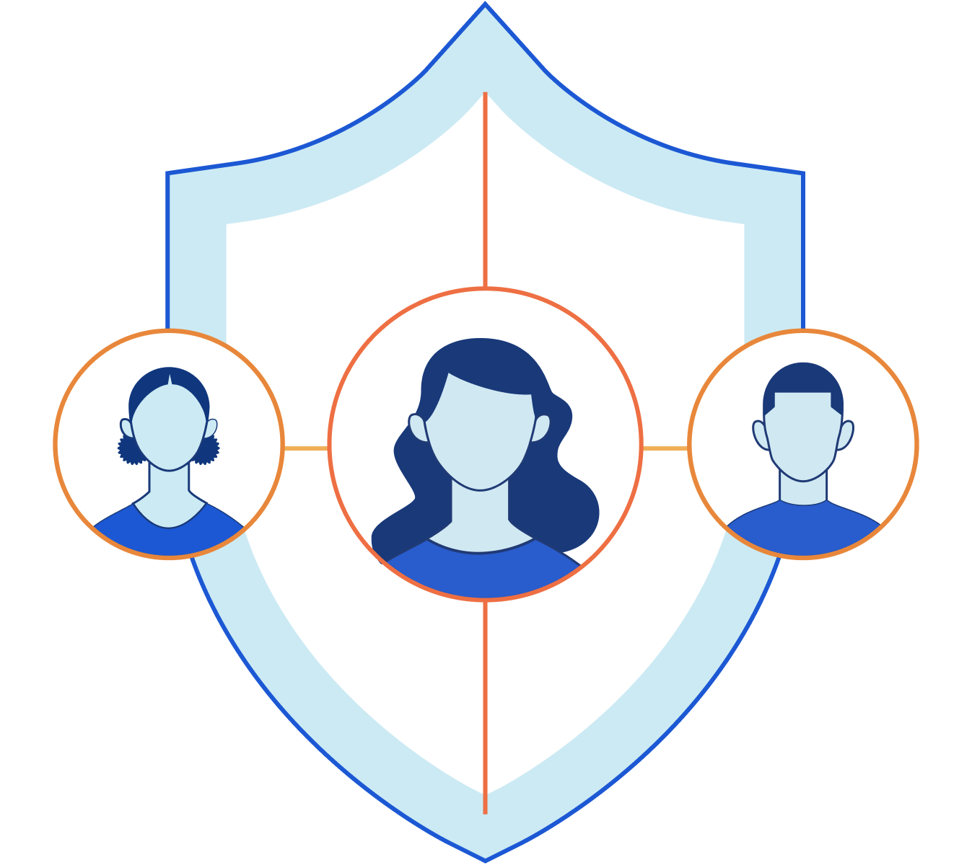

Cloudflare for Teams Demo Example
Use Case:
Working from Home
Accessing Internet (e.g. Facebook), SaaS app (e.g. Salesforce?), Internal app (e.g. Jira)
Personas:
Carol, employee working from home.
Susan, IT Administrator

Slide 40
Cloudflare for Teams Demo: Structure
Architecture Overview: Whiteboard (or pre-canned slide, see appendix)
Prerequisite: Configure IDP
Browsing the Internet
Create Gateway Policies (content categories, security risks, block downloads to GDrive)
Configure Browser Isolation for Social Media (or news website)
End User Experience: Browse to Facebook, browse to malicious site
Visibility through logs
Accessing an Internal App
Create app + policies (require Gateway, serial number)
Configure Cloudflare Tunnel
End User Experience: Login to web app
Visibility through logs
Accessing a SaaS App (maybe remove this bit because it’s not easy to demo)
Create SaaS app + policies (require Gateway, serial number)
Block access to admin page
SaaS app: Configure SAML
End User Experience
Visibility through logs

Slide 41

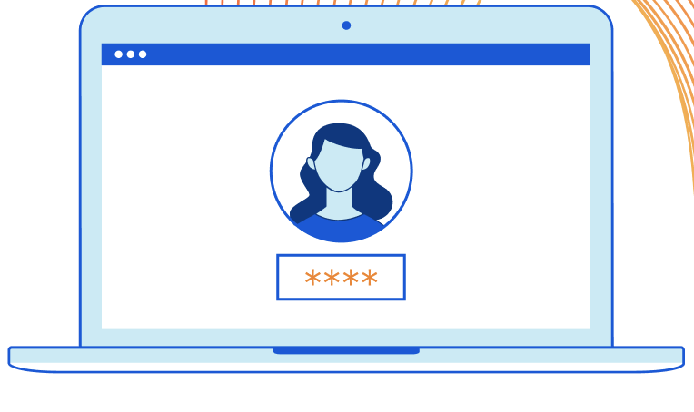
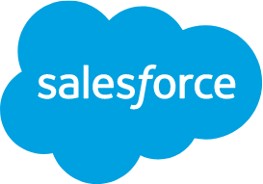
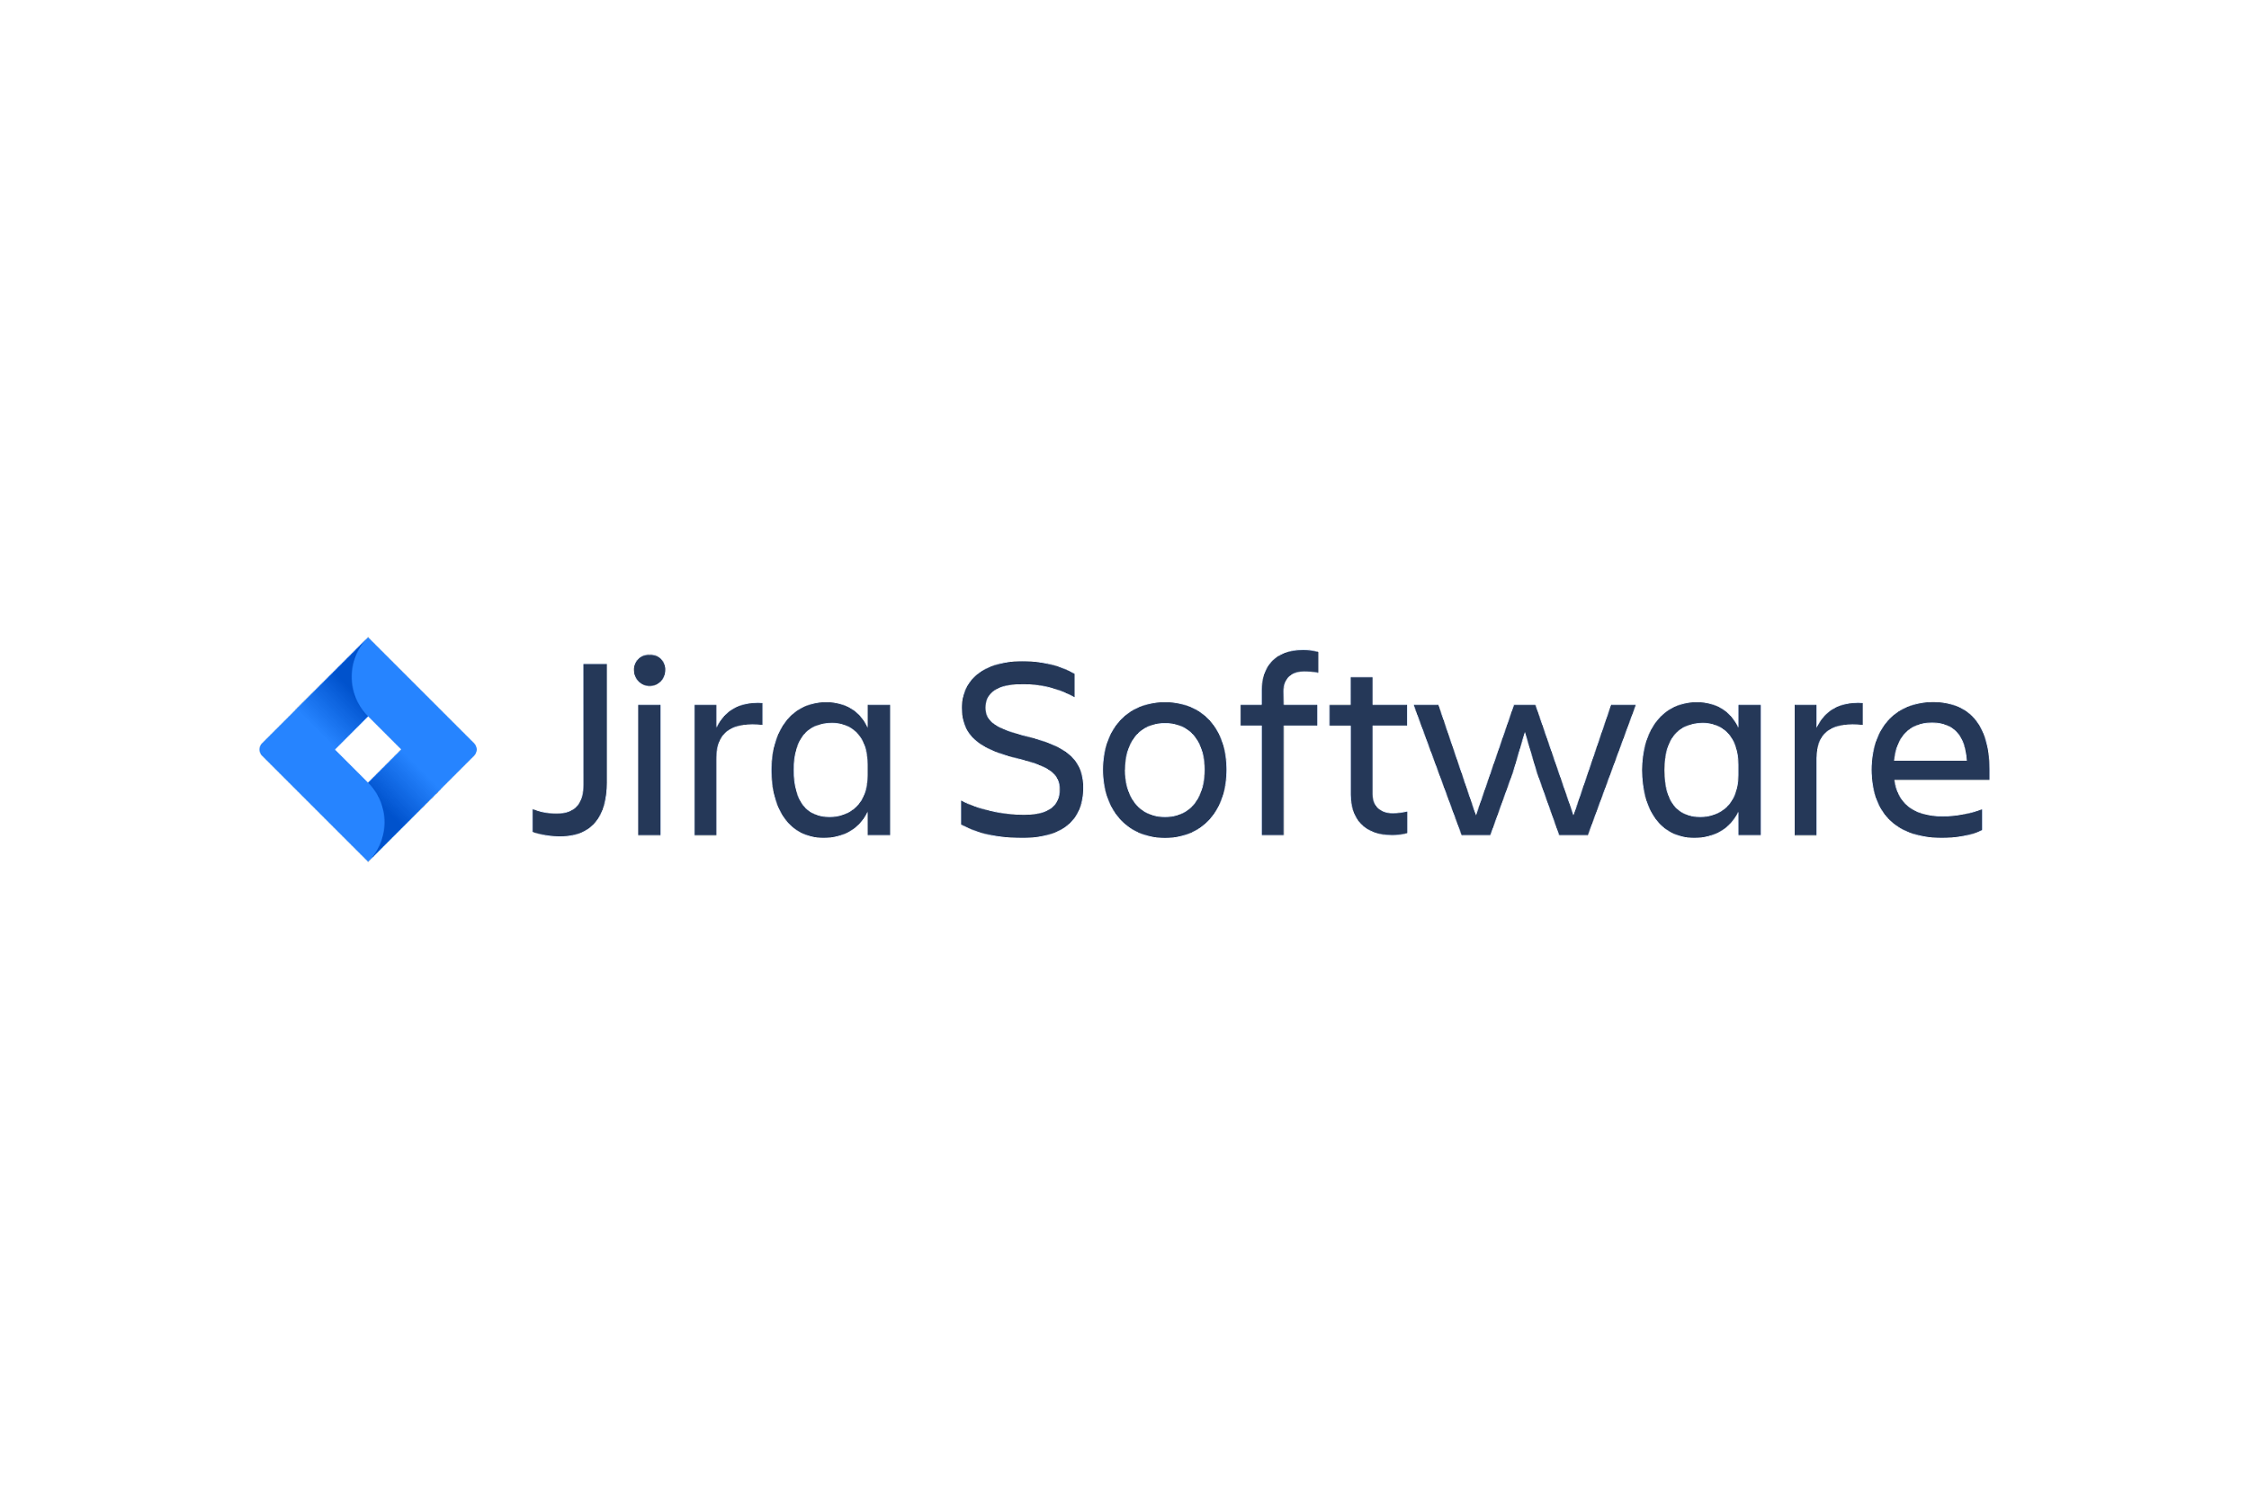
Why does Susan in security care about what Carol is doing?
Zero Trust security in the real world
Here’s what worries me.
I’m here to make sure that only the right people can access customer data, and that we don’t lose track of it.
Malvertising risks
Must have latest device OS to access
Must be on corporate machine
Stop CSV downloads of data
Block access to admin pages
Prevent access from certain countries
Must have latest device OS to access
Must be on corporate machine to access
Stop copy/paste of code samples in app

Slide 42
With Browser Isolation, I gain protection from threats I otherwise miss.
Zero trust security in the real world
Here’s how adding Cloudflare for Teams helps me protect our data.
- Browse marketplace
- Look at photos
Internet
- View reports
- download report
- Research opps
TEAMS [SWG + ZTNA + BROWSER]
OKTA [IDP]
+ Yubikey
SaaS
Carbon Black [EPP]
- Check status of features
- Create design tickets
OKTA [IDP]
+ Yubikey
Datacenter

Slide 43
With everything working together, I have defense against data loss.
Zero trust security in the real world
Here’s how adding Cloudflare for Teams helps me protect our data.
- Browse marketplace
- [X] click on banner ad!
- Look at photos
Internet
- View reports
- [X] download report!
- Research opps
TEAMS [SWG + ZTNA + BROWSER]
OKTA [IDP]
+ Yubikey
SaaS
Carbon Black [EPP]
- Check status of features
- [X] share code samples!
- Create design tickets
OKTA [IDP]
+ Yubikey
Datacenter
USER IDENTITY, ACTION, ALLOW/BLOCK/ISOLATE ACTION LOGGED

Slide 44
Cloudflare for Teams Demo
Tips
Show what’s relevant to the customer
Consider your audience: technical vs non-technical
Highlight key sales points: benefits/differentiators
Highlight solved pain points as you go along
Demonstrate value, not products

Slide 45
Resources

Slide 46
Resources
Customer Facing Documentation
https://developers.cloudflare.com/cloudflare-one
Customer Facing Documentation > Tutorials (Great for use cases)
https://developers.cloudflare.com/cloudflare-one/tutorials

Slide 47
Appendix: Demo Diagrams

Slide 48
Cloudflare Access

Slide 49
Zero Trust Network Access with Private Routing
User
Cloudflare Edge
Resource
managed devices or not, employees or contractors
Web and non-Web apps,
SSH and RDP connections
Multiple identity providers
Login method, auth method, group
Cloudflare Tunnel
Self-hosted apps
Client on device
via wireguard protocol L4-7 private routing
RDP & SSH built-in
Device posture
EPP active, serial #, valid cert
DDoS protected
L4 firewall (optional L7 WAF)
Private IPs (and soon, hostnames)
Context
both via cloudflare-d in data center or cloud
Geo location, network, app path
Clientless
via any browser and/or mTLS cert
HTTPS
In-browser terminal
Clientless support for SSH and VNC
SAML log in
SaaS apps
via SAML log in
Notes:
It adds how a client on the users’ device with built in support for thick-client apps such as RDP and SSH establishes a Wireguard tunnel to Cloudflare’s edge, which privately routes TCP traffic over Cloudflare’s network to a corresponding Cloudflare Tunnel that can reach the requested private IPs (and soon, private hostnames). But not before every request is authenticated and authorized based on verifying the identity, including specific auth methods such a hard token, device posture, and context like the origin’s country. These are the same Zero Trust rules that we use now for clientless operation to self-hosted apps or SaaS apps. But instead of configuring ingress rules per application, customers can use our layer 4 firewall to configure identity-based network rules to restrict lateral movement per private subnet.

Slide 50
Cloudflare Gateway
Cloudflare for Teams
Notes:
Let’s move on to talk about our Secure Web Gateway, which you can use to protect your employees from threats on the Internet, no matter where they connect from.

Slide 51
Cloudflare Gateway
Identity-Based Policy Engine
Recursive DNS Resolver
Security, Content, and Application Groups Domain and IP Filters
DNS query
Office user
Known location IP
Coming soon: L4-7 traffic
Traffic Inspection Proxy
HTTPS Decryption, File and Data Scanning, AV URL, HTTP, and MIME/File Type Filters
app.com
Encrypted L4-7 traffic
Zero Trust Browser
Untrusted Web Code Executed Away From Device Coming Soon: Copy/Paste, Print, Input Controls
Remote user
Device Agent
Notes:
V2

Slide 52
Cloudflare Browser
Cloudflare for Teams
Notes:
Let’s move on to talk about our Secure Web Gateway, which you can use to protect your employees from threats on the Internet, no matter where they connect from.

Slide 53
Isolate endpoints from untrusted and malicious web code

